Slide 1

Let’s talk about the Summer Olympics
By
LaShawn Gaines

Slide 2
agenda
Datasets leveraged
Data wrangling journey
Questions and Insights
Conclusions

Slide 3
Datasets leveraged
For historical Olympic data from 1896 – 2020:
Published by Joseph Cheng
https://www.kaggle.com/datasets/josephcheng123456/olympic-historical-dataset-from-olympediaorg/data
For 2024 Paris Summer Olympics data:
Published by Petro
https://www.kaggle.com/datasets/piterfm/paris-2024-olympic-summer-games/data
For information on 2024 medal bonuses
Published by Shirley Gomez with Hola!
https://www.hola.com/us/entertainment/20240731710268/medal-bonuses-at-the-2024-paris-olympics-how-much-countries-will-pay-their-victorious-athletes/

Slide 4
Data wrangling journey
Alignment
Aligning the datasets with pandas
Dropping columns from the historical data set
Adding columns to the 2024 data set
Concatenation
Concatenating the data sets to review trends
Consistency
Ensuring that the country names were consistent across the datasets (China and Russia for example)
Challenges
Missing data for Russia and China in historical dataset

Slide 5

Questions asked

Slide 6
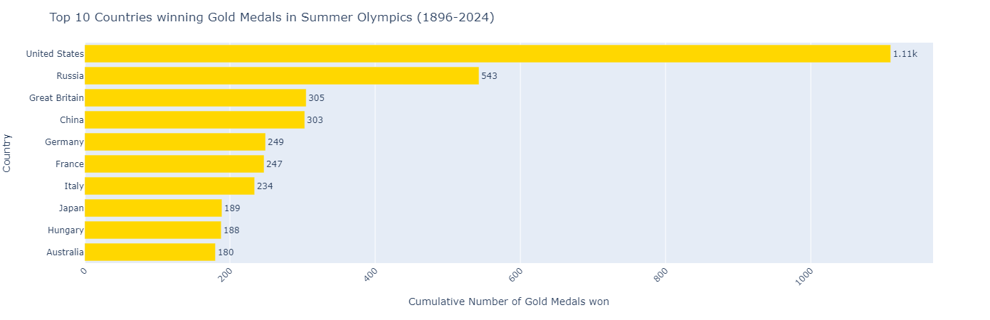
Who wins the most Olympic gold medals?
The US and China topped the chart in 2024 with 40 gold medals
United states won the tie breaker based on all medals won
The United States also reigns supreme in gold medals for the modern Olympics (1896-2024)

Slide 7
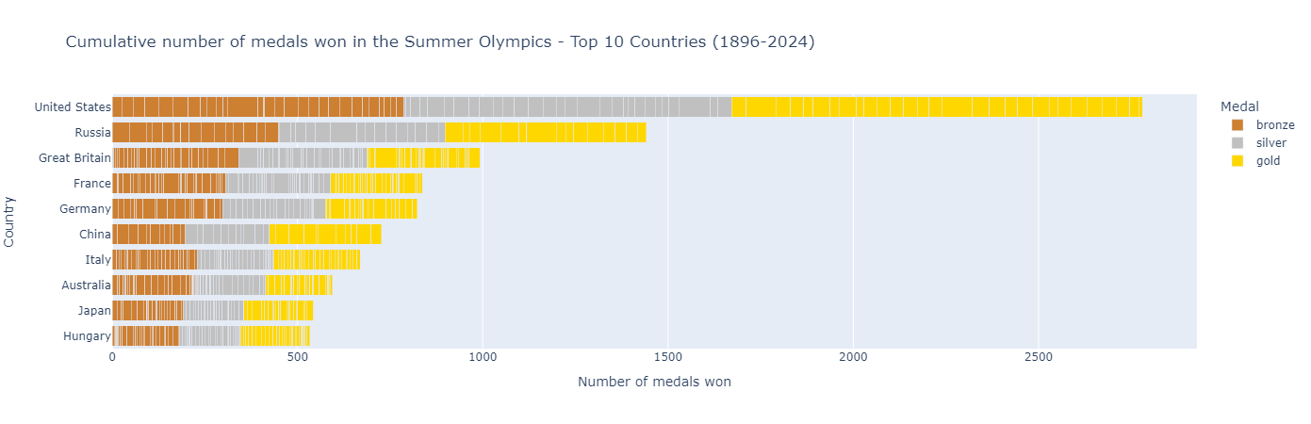
Who wins the most Olympic medals?
Again, the United States takes top honors
Russia is still second, even after sanctions
In 2020 due to doping
In 2024 due to war in Ukraine

Slide 8
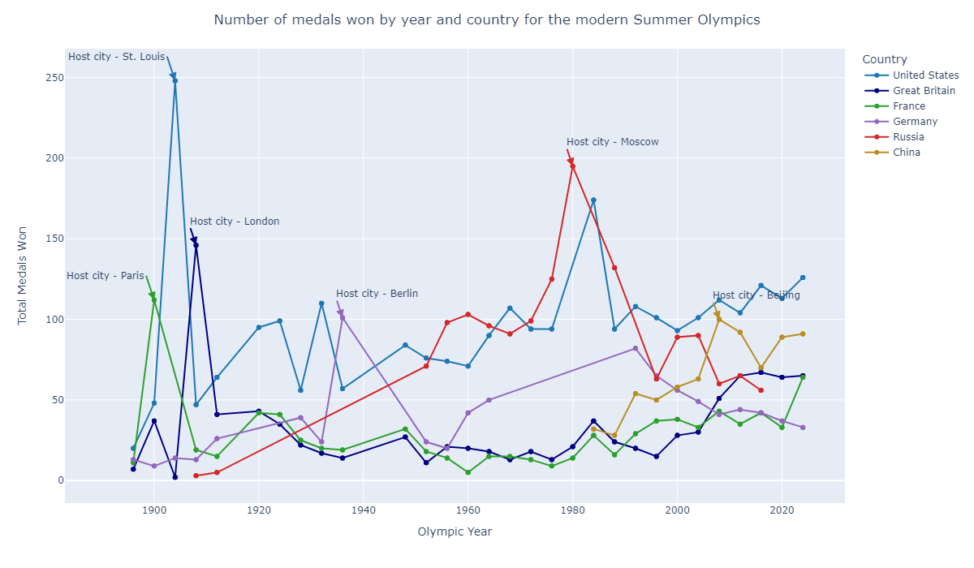
Who won the most medals by Olympic games?
Often, the host country sees a spike in medals won
China has moved solidly into second place since the 2008 Beijing games
Russia has been banned from the Olympics since 2020

Slide 9
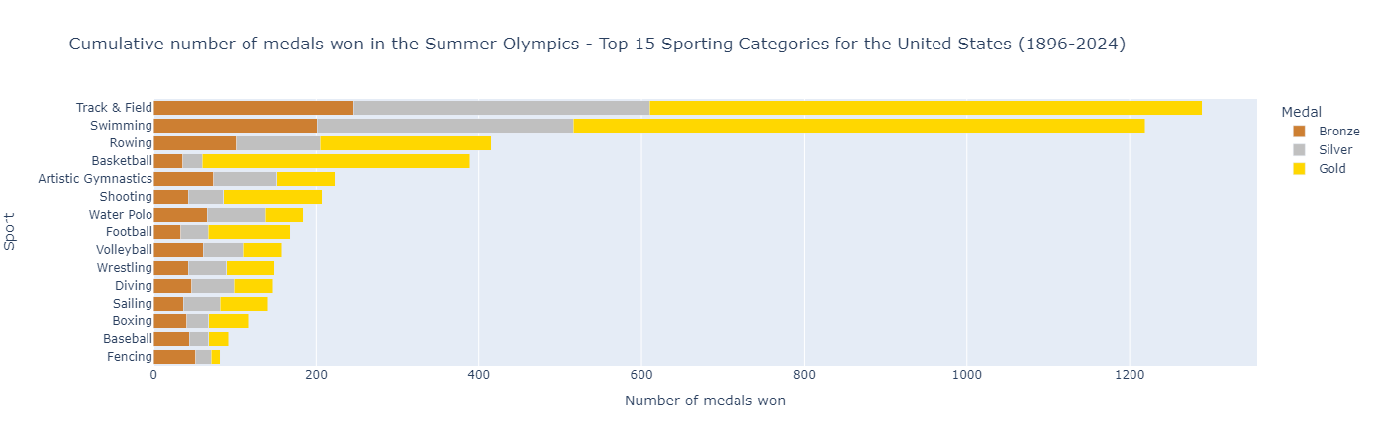
Which sports contribute the most medals to the United States?
Track & Field has edged out Swimming for the top spot
Given the dominance of the NBA and WNBA it is no surprise that Basketball appears in the top 5
Rowing and Gymnastics round out the top 5

Slide 10
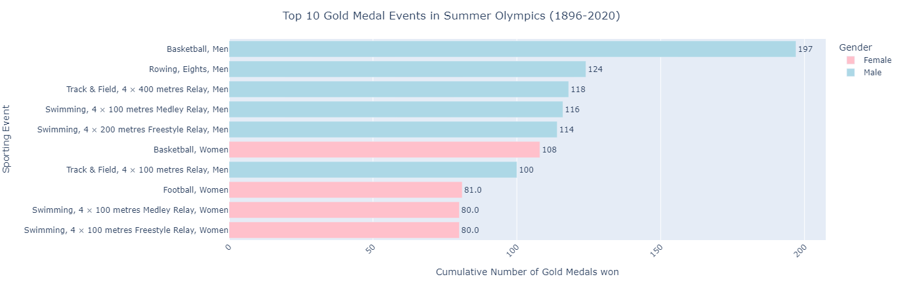
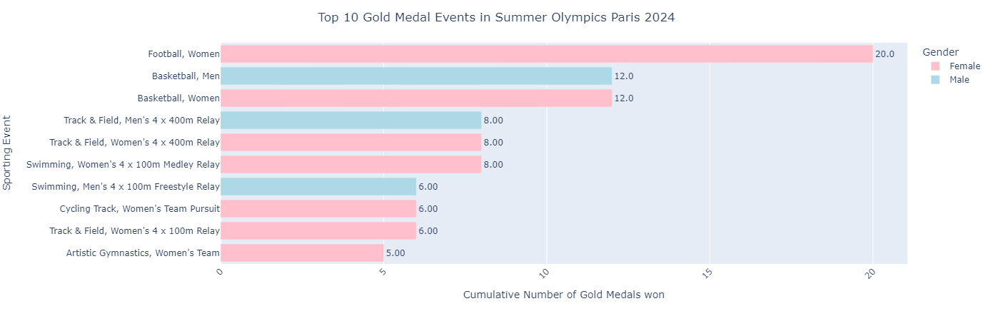
Does gender play a role in the number of medals won for the United States?
Historically, men’s events have produced more medals for the US
By the 2024 Paris Olympics there appears to be a shift towards the women’s events

Slide 11
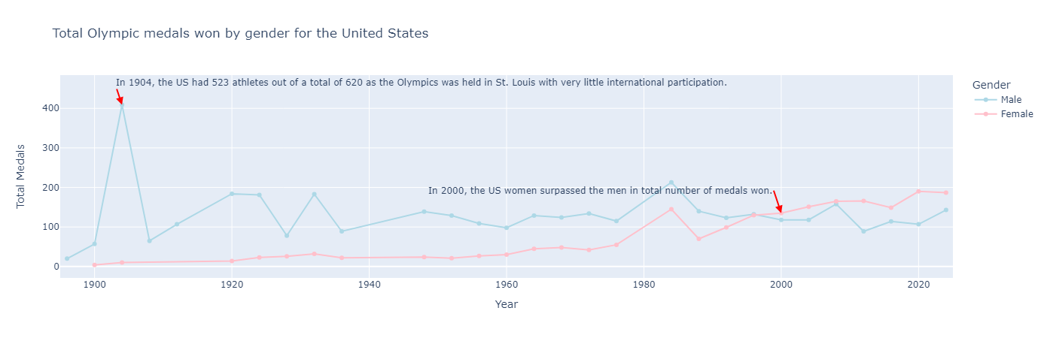
When did the US women pass the men in total medals at the Summer Olympics?

Slide 12
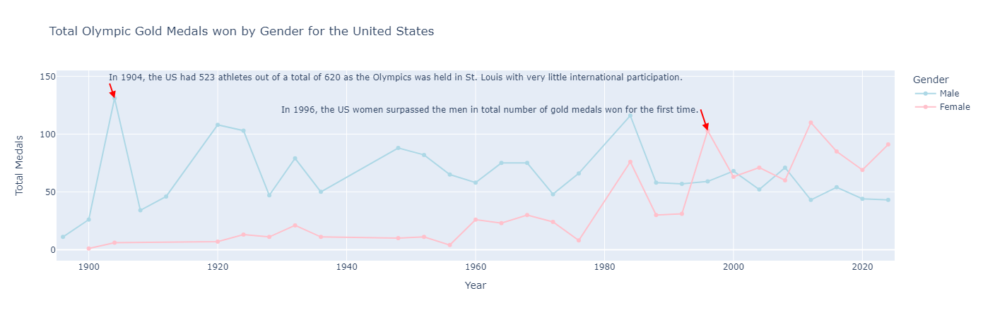
When did the US women surpass men in gold medals at the Summer Olympics?
US women outperformed men in earning gold medals for the first time in 1996
By 2020, they would also outperform the US men in all medals won.

Slide 13
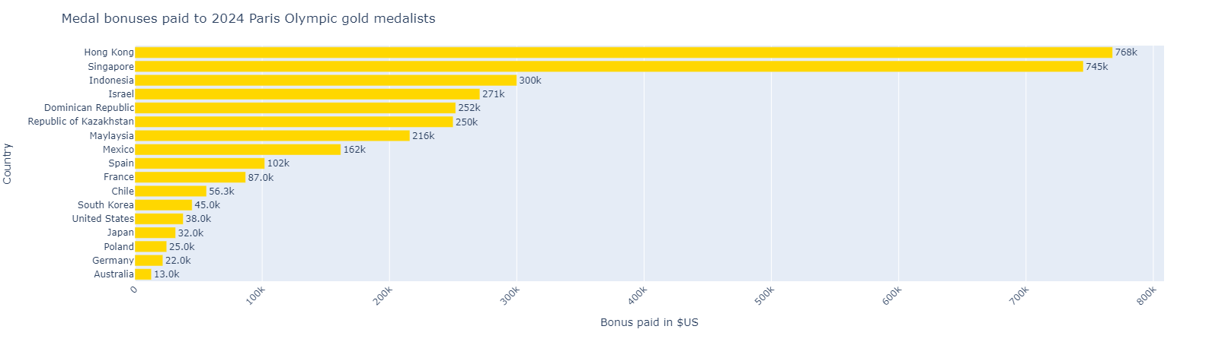
How much are medal winning athletes awarded?
The United States is not the most lucrative in medal bonuses awarded, that would be Hong Kong
The International Olympic Committee does not compensate the medalists
The amounts awarded are set and paid by the participating countries

Slide 14
Conclusions
In the modern Olympic games (beginning 1896) the United States has consistently topped the medal counts
Russia and China have consistently been the closest competition to the United States in winning medals
The host nation for the Olympics typically sees a spike in medals won
In the last 3 decades the US women have grown to be quite formidable in winning medals and now outperform the US men.
Track & Field has resulted in the most medals for the United States.
Hong Kong is the place to be, to be awarded the most cash for a gold medal.

